Slide 1
Docker
setup

Slide 2
Setup
Image
Container
Docker.com account
Docker application
The docker hub repository
Local launch
Publishing
Launching in another system
$ docker build
Your App
Dockerfile
Image
$ docker run

Slide 3

Create an account on docker.com
https://www.docker.com/get-started/
This will allow you to create, version and share your own docker images

Slide 4
Install the Docker Desktop
https://www.docker.com/get-started/

Slide 5
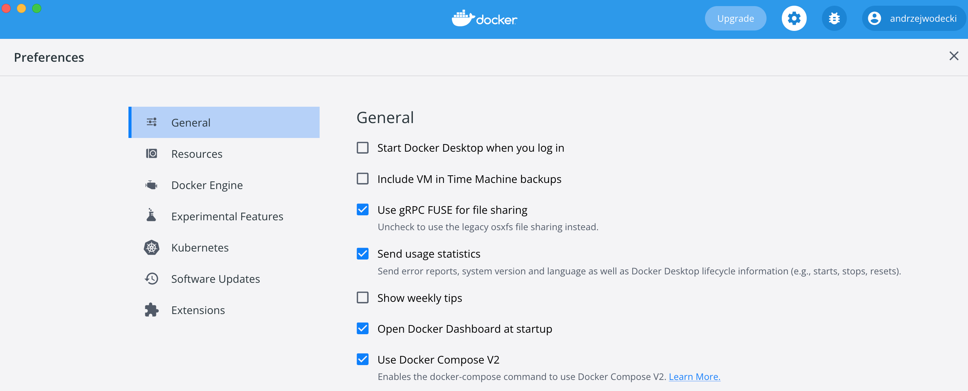
Log in
Settings > Sign-in

Slide 6
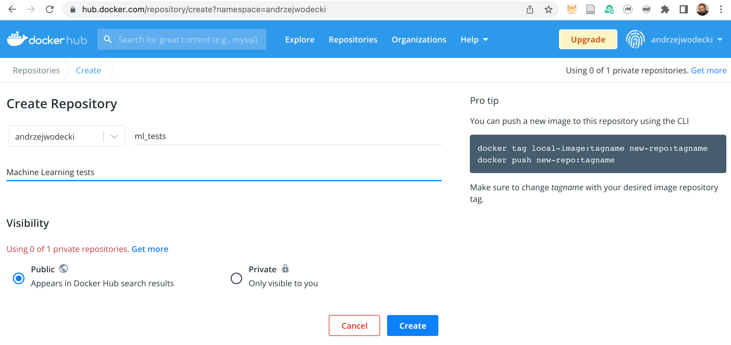
Create your first image repository in Docker Hub
https://hub.docker.com/ > Create Repository

Slide 7
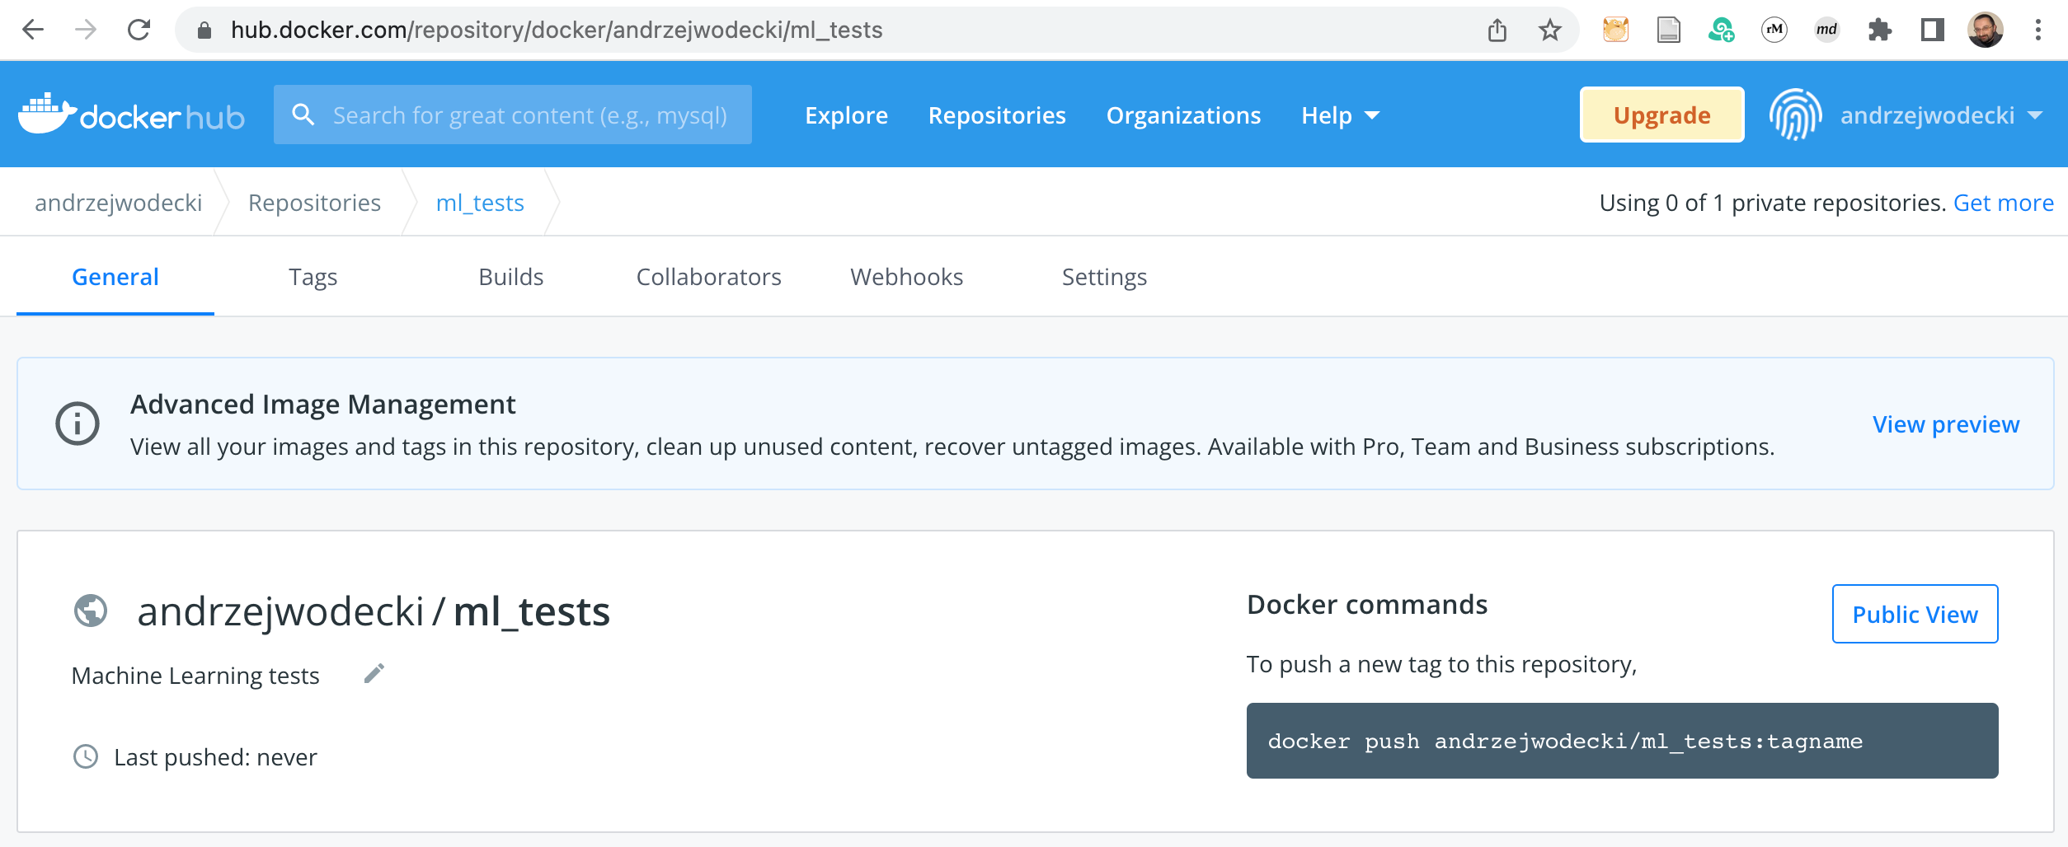
This is where you will collect your images
To push the image into this repository:
$ docker push your_account/ml_tests:tagname
your_account/ml_tests: image name (= repository name)
tagname: name of Your image

Slide 8
Setup
Image
Container
Docker.com account
Docker application
The docker hub repository
Local launch
Publishing
Launching in another system
$ docker build
Your App
Dockerfile
Image
$ docker run

Slide 9
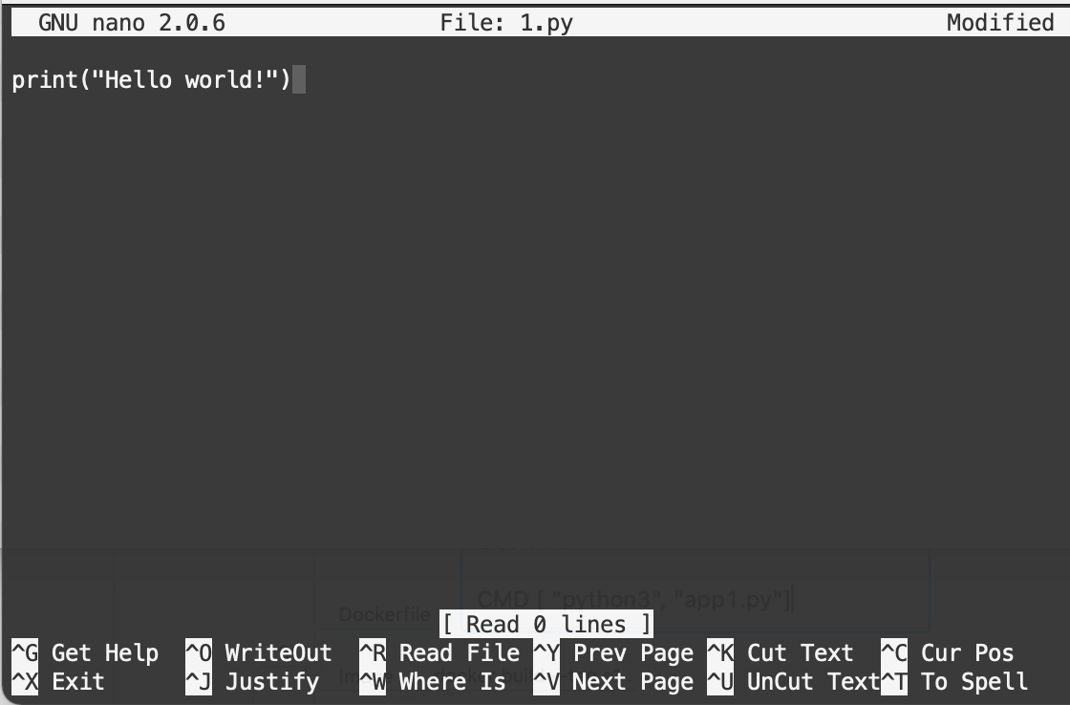
First application
Create a folder First application
Create a file 1.py in it
Add one command to it:
print("Hello world!")

Slide 10
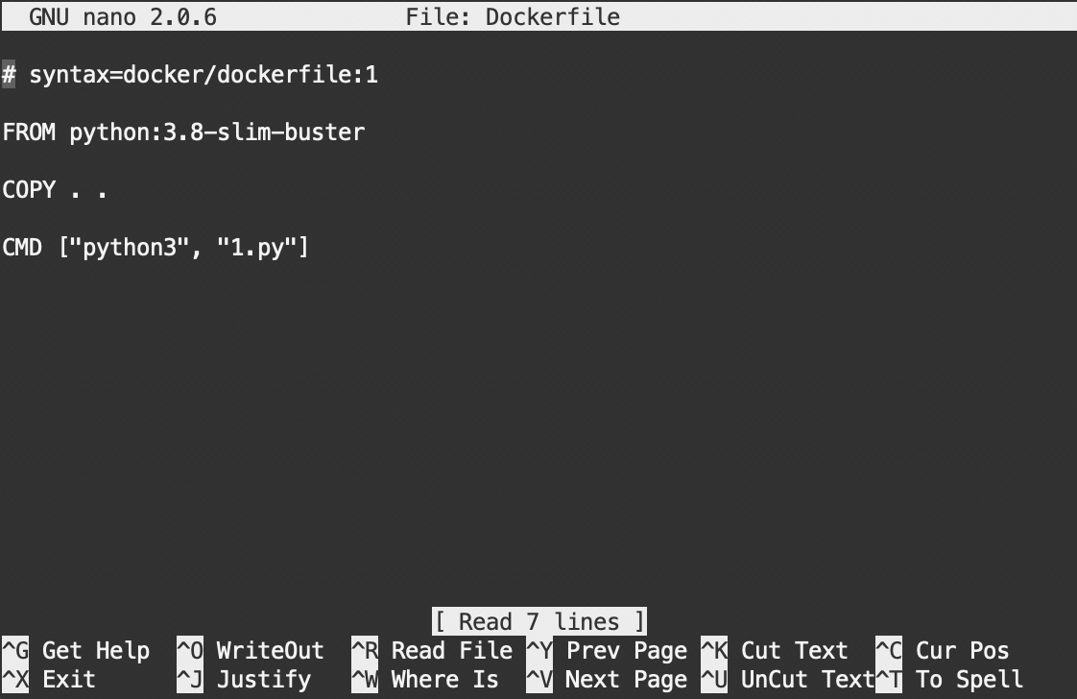
Create a Dockerfile
In the First application folder, create a Dockerfile
The contents of the file are presented on the screen next to

Slide 11
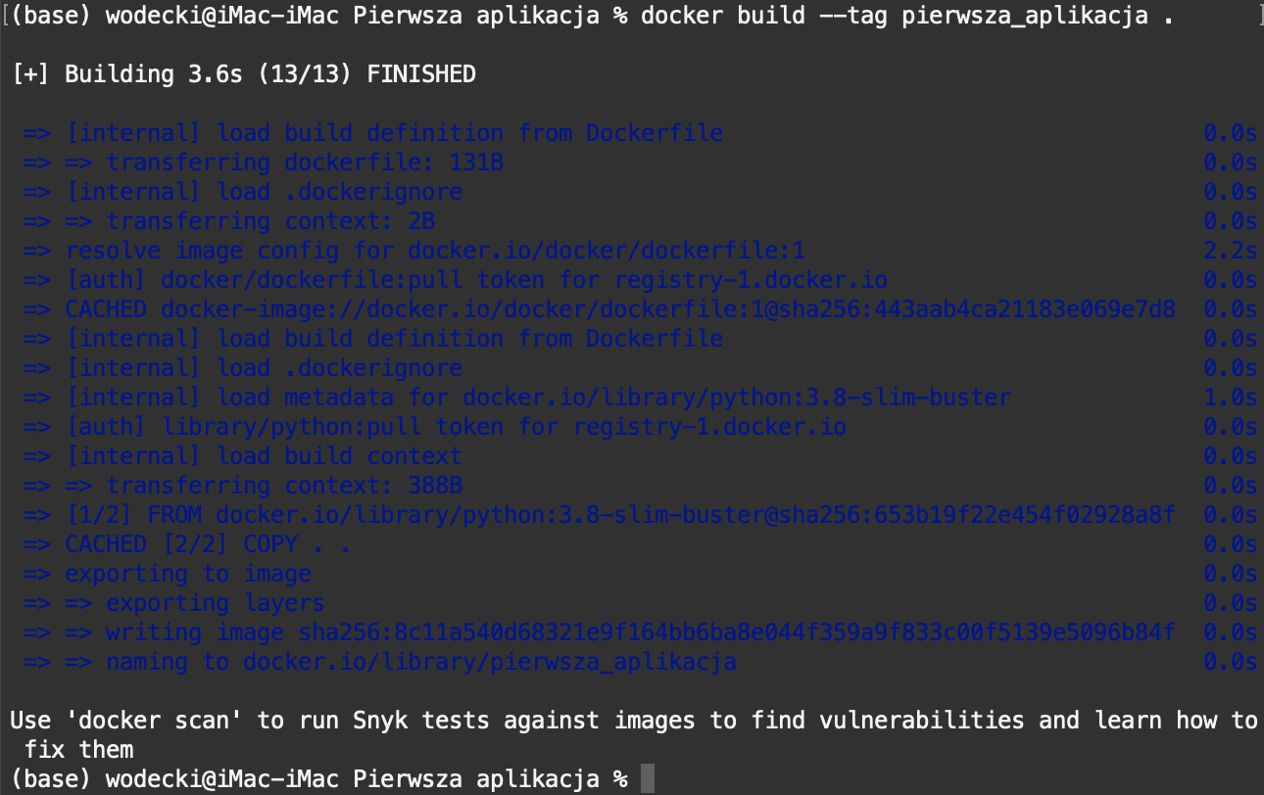
Build docker image locally
To create an image named first_application, at the command line run:
$ docker build --tag first_application:v1 .
The --tag flag is used to name the image:
- Before the ":" character: image name (first_application)
- After the ":": image tag (v1)

Slide 12
Setup
Image
Container
Docker.com account
Docker application
The docker hub repository
Local launch
Publishing
Launching in another system
$ docker build
Your App
Dockerfile
Image
$ docker run

Slide 13
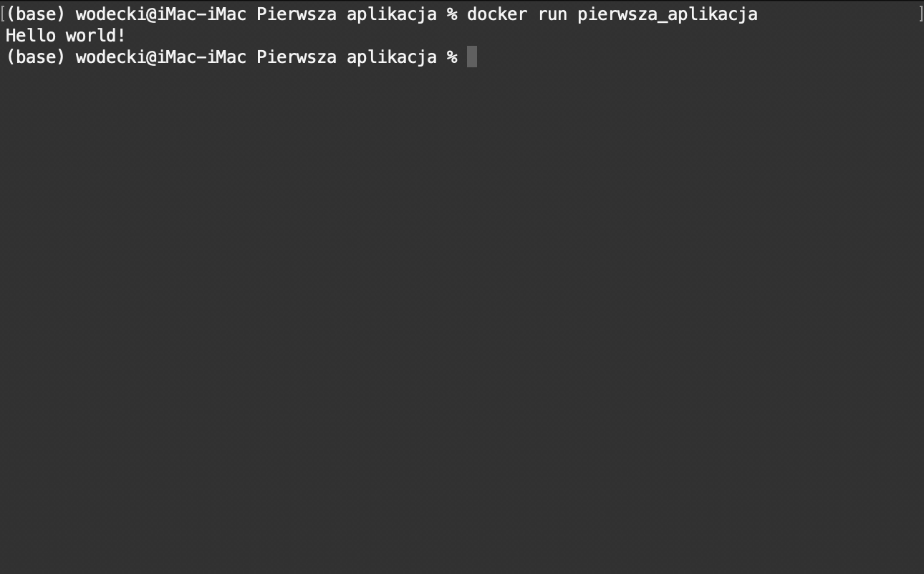
Run the container locally
On the command line, run:
$ docker run first_application:v1

Slide 14
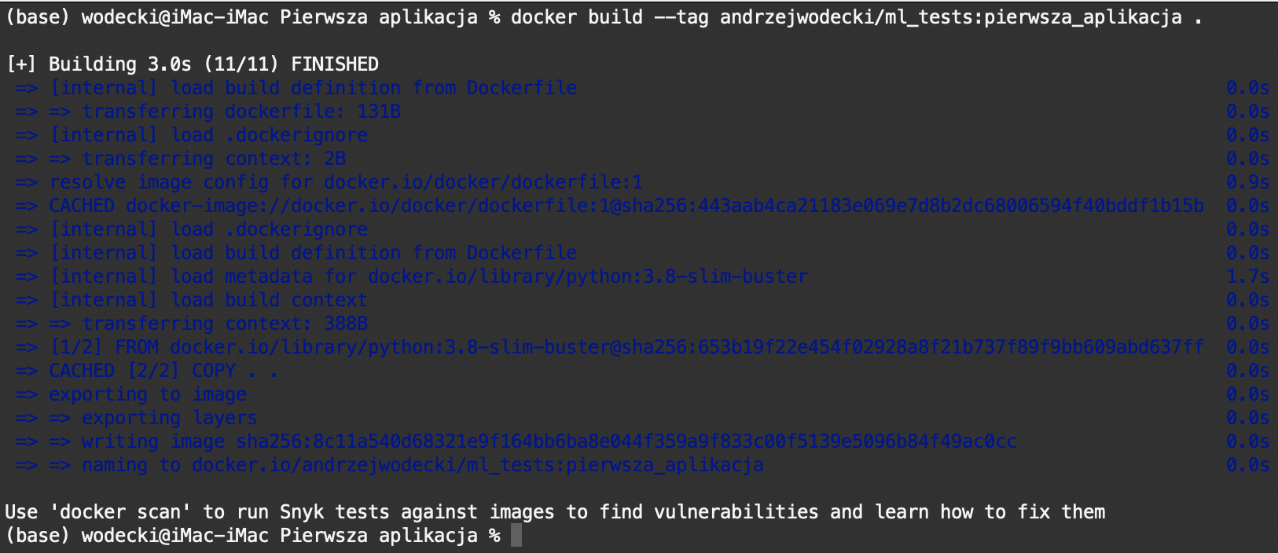
Create an image with an appropriate name
To publish your image to the Docker Hub repository, you need to give it a proper name.
At the command line, run (replacing andrzejwodecki/ml_tests with your own repository name):
$ docker build -t andrzejwodecki/ml_tests:first_application .

Slide 15
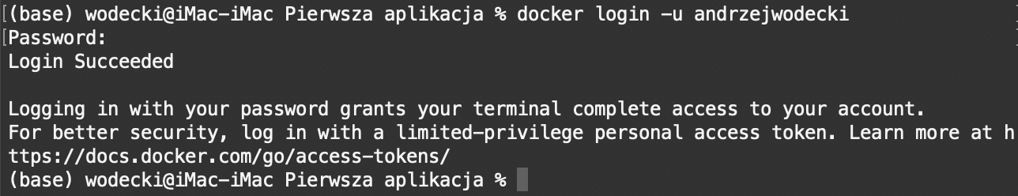
Log in to your Docker Hub repository
This is a one-time action required to publish the image to the Docker Hub repository:
$ docker login -u andrzejwodecki

Slide 16
Run the container from Docker Hub locally
... to see if it works.
On the command line, run (replacing andrzejwodecki/ml_tests with your own repository name):
$ docker run andrzejwodecki/ml_tests:first_application

Slide 17
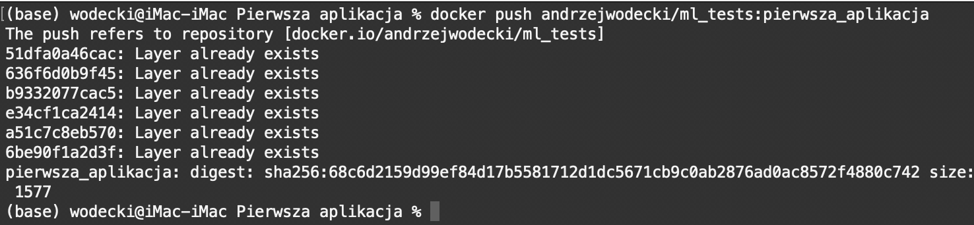
Publish the docker image to your Docker Hub repository
At the command line, run (replacing andrzejwodecki/ml_tests with your own repository name):
$ docker push andrzejwodecki/ml_tests:first_application

Slide 18
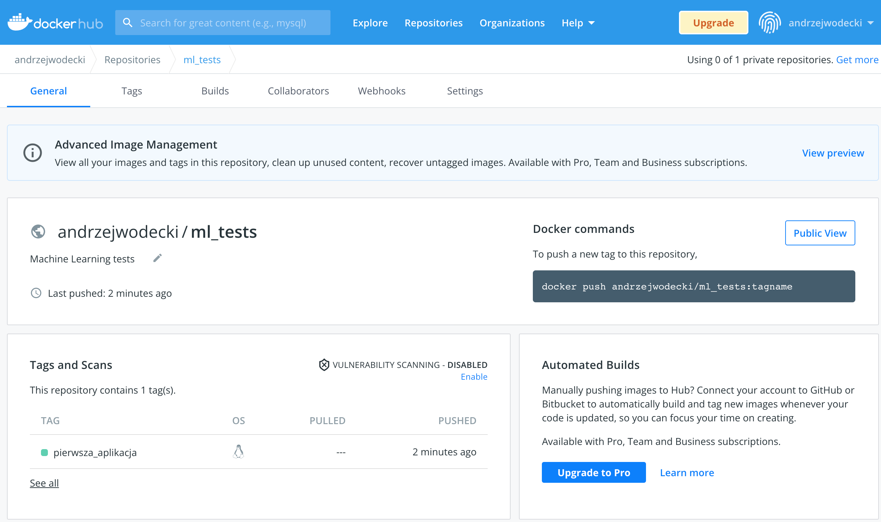
Check the availability of the image in your repository
Log in to your account at hub.docker.com
Go to the appropriate repository (in my case: ml_tests)
Check the availability of the image in the Tags and Scans section

Slide 19
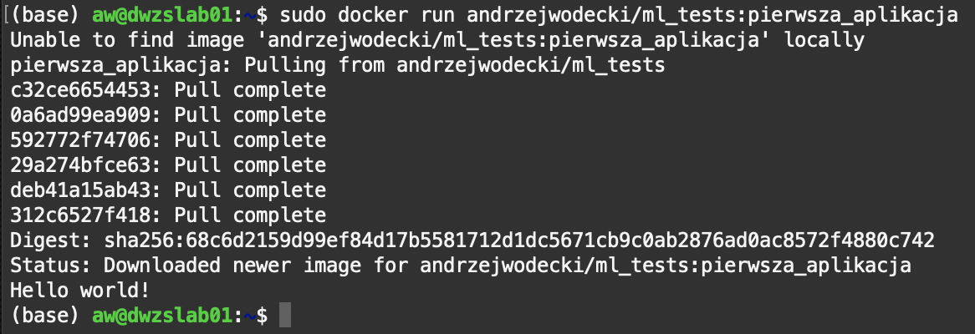
Run your image on another system
To use your image on another system, users should:
1. On the new system, install the Docker application
2. At the command line, run:
$ docker run andrzejwodecki/ml_tests:first_application
NOTES:
1. in the last command, of course, you should replace
andrzejwodecki/ml_tests
to the name of your own repository.
2. Sometimes running docker requires administrative privileges (cf. the screen opposite). In such a situation, a practical solution is to create a docker user group and add it to the sudo group (https://docs.docker.com/engine/install/linux-postinstall/)

Slide 20
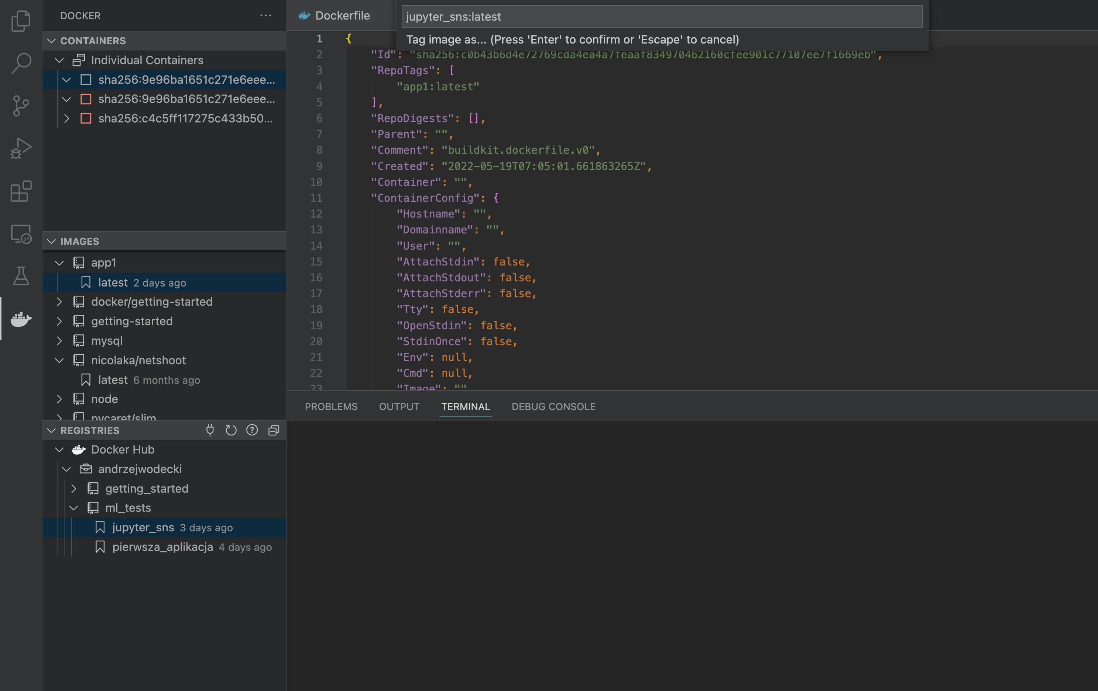
Tip: use the Docker plug-in in MS VSCode to inspect your images
The MS VSCode environment allows for simple inspection of images and containers, both locally and in a repository.
You can in particular:
1. For images
- Download and transfer to the repository
- Run
- Perform inspections (inspect)
- Rename, delete
2. For containers:
- Check and change status (start, stop, restart)
- View and edit files

Slide 21
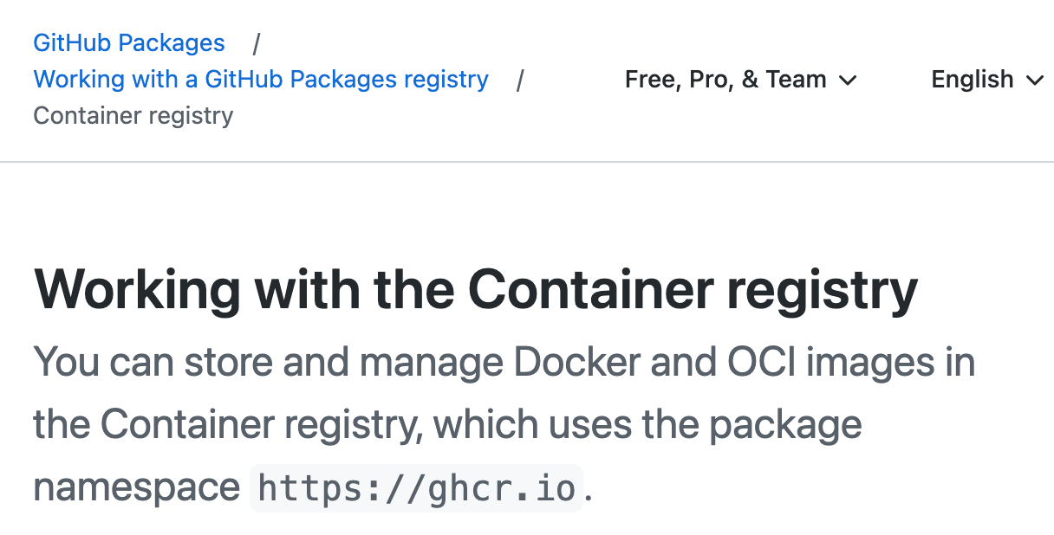
Publish the docker image on GitHub
You can also publish your docker images on GitHub using http://ghcr.io
https://docs.github.com/en/packages/working-with-a-github-packages-registry/working-with-the-container-registry

Slide 22
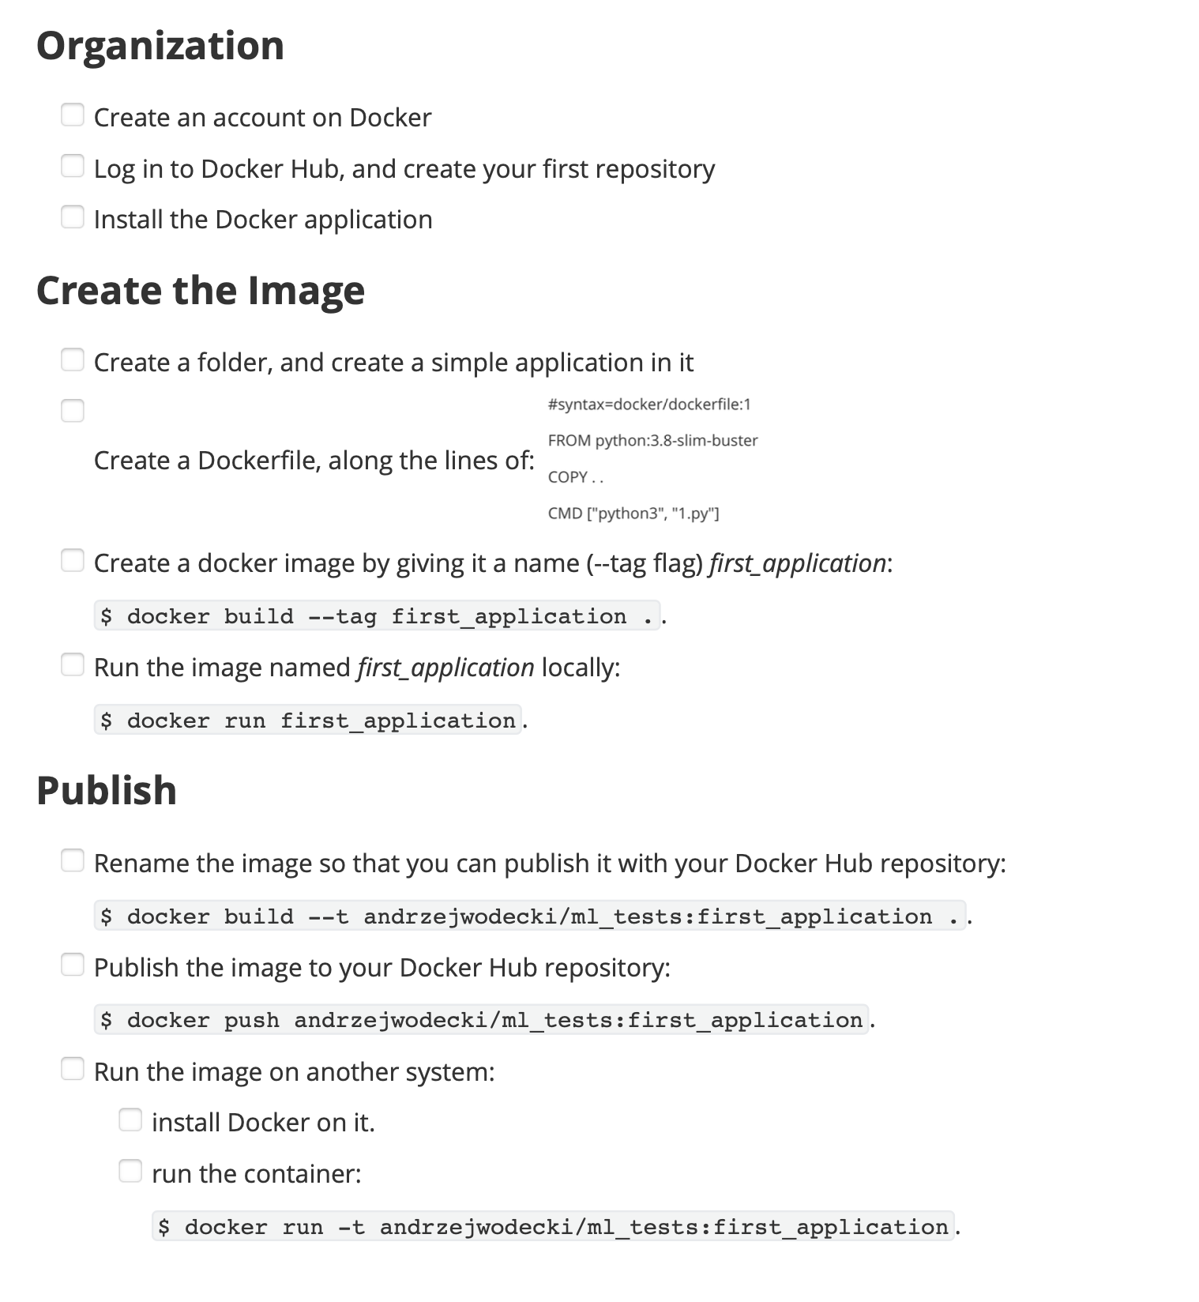
Summary

